Slide 1
CS487-Introduction to competitive programming: A2SV
Lecture #14 Greedy Approach

Slide 2
Greedy Approach
Algorithmic paradigm that builds up a solution step by step, always choosing the next step that offers the highest benefit
Choosing local optimal steps must yield to global optimal in the end

Slide 3
How To Notice (Requirements)
Greedy choice property
Optimal substructure property

Slide 4
Greedy Choice Property
From a local optimum, global optimum is reachable without taking a step back

Slide 5
Optimal Substructure Property
Optimal solution can be determined from the optimal solutions of subproblems

Slide 6
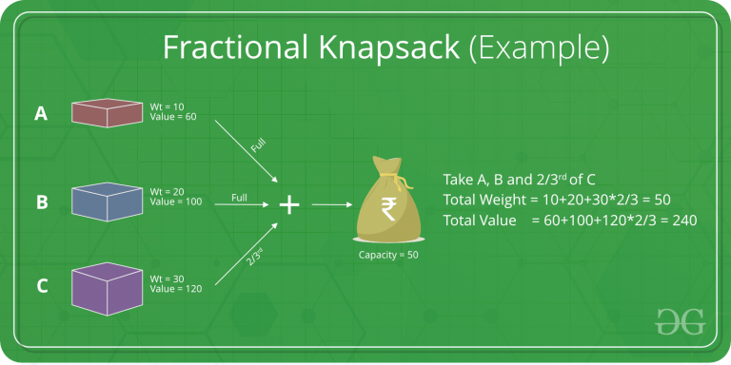
Fractional Knapsack
Problem: Given goods with different weight and values, try to collect as much value as possible for the given capacity, goods can be captured in fractions
Check for greedy choice property
From a local optimum, global optimum is reachable without taking a step back
Check Optimal substructure property
Optimal solution can be determined from the optimal solutions of subproblems

Slide 7

Activity Selection
Problem: Given activities with start and end times, choose the most number of them that do not intersect with each other
Check for greedy choice property
From a local optimum, global optimum is reachable without taking a step back
Check Optimal substructure property
Optimal solution can be determined from the optimal solutions of subproblems

Slide 8
Egyptian Fraction
Problem: Given a fraction, write it in the form of 1/x1 + 1/x2 + 1/x3 + ...
Check for greedy choice property
From a local optimum, global optimum is reachable without taking a step back
Check Optimal substructure property
Optimal solution can be determined from the optimal solutions of subproblems

Slide 9
Programming Exercises
TODO(Emre): Add problems

Slide 10
Quote of the day
"Do not wish for an easy life. Wish for the strength to endure a difficult one." —Bruce Lee

